Slide 1

ICC T20 WORLD CUP 2020 WIN PREDICTOR
Presented By Roll No
Aqib Anwar
Jayakrishnan MS
Jibin K George
Jinesh Gireesan
24
51
53
54

Slide 2
INDEX
Introduction
Objective
Tools required
Data
Decision Tree Classification
Random Forest Classification
Workflow
Feature Engineering
Relevance of Prediction Models
Reference
3
4
5 – 12
13
14 – 15
16
17
18
19
20

Slide 3
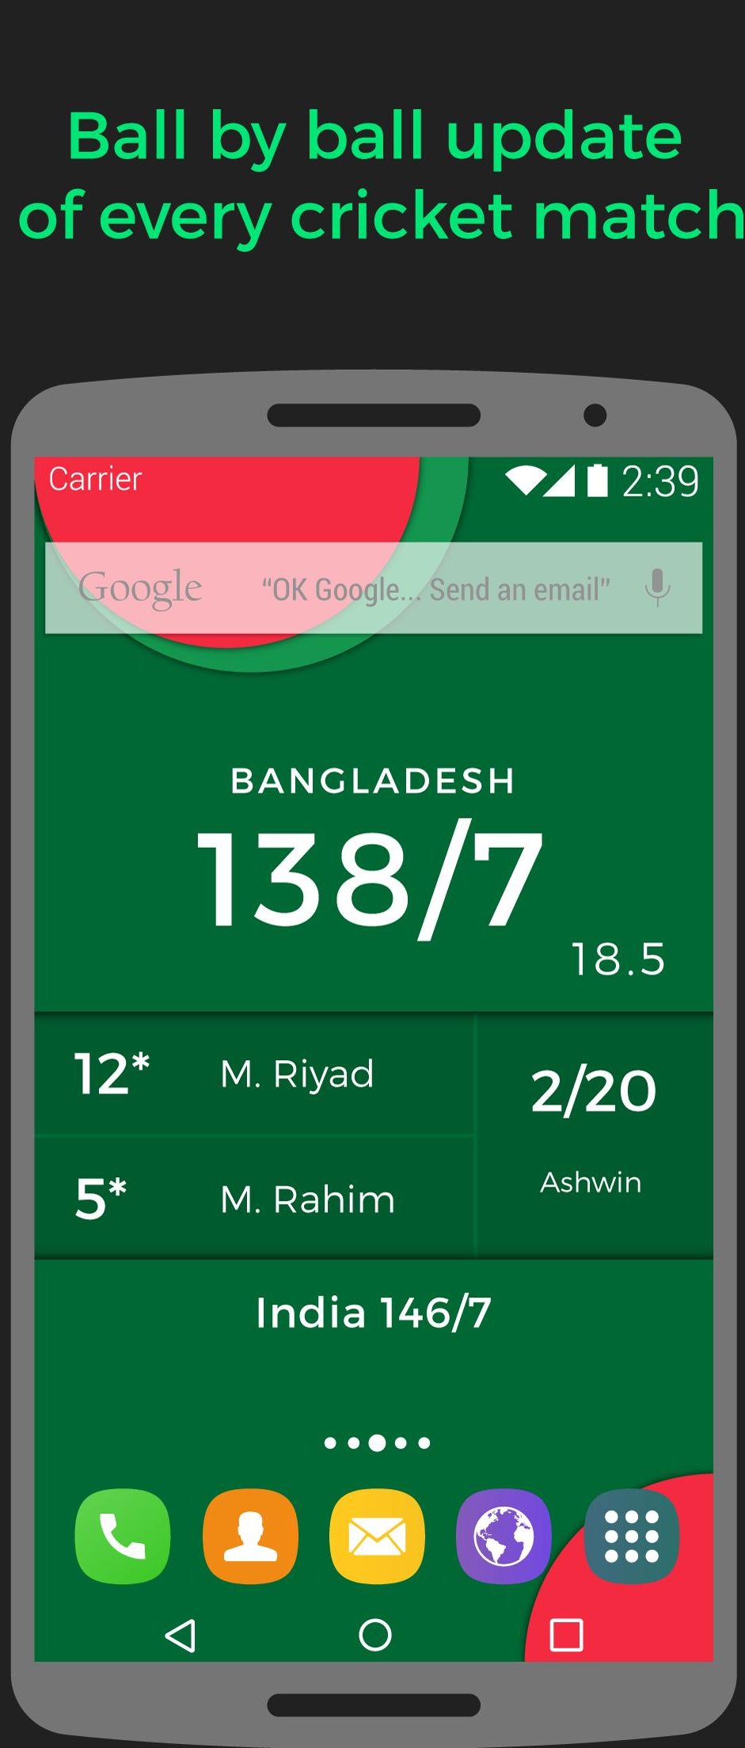
INTRODUCTION
There is numerous amount of data we obtain from a cricket match.
Runs, wickets, run rate, economy, average, player strengths and weaknesses etc.
Machine Learning has a role to play wherever data is involved.
Cricket betting is a multi-billion dollar market.
There is a strong incentive for models that can predict the outcomes of games and beat the odds provided by bookers.

Slide 4
OBJECTIVE OF THE PRODUCT
The aim of this project is to create an application to predict the results of the fixtures of T20 world cup 2020
We train our prediction model using International T20 results of the last 10 years.
Our model only uses ‘ranking’, ‘match results’ and ‘performance in past world cups’ as training data.
The prediction model can be made more accurate with individual player data
But complex programming requires more time and knowledge in ML algorithms.
Considering the data acquired from cricket matches, our model is not much accurate.

Slide 5

ENVIRONMENT &
TOOLS REQUIRED
Jupyter Notebook
NumPy
Matplotlib
Pandas
Seaborn
Scikit-learn

Slide 6

THE JUPYTER NOTEBOOK
“The Jupyter Notebook is an open-source web application that allows you to create and share documents that contain live code, equations, visualizations and narrative text”
A web-based interactive computational environment for creating Jupyter notebook documents(.ipynb extension).
Jupyter Notebook can connect to many kernels to allow programming in many languages.
By default Jupyter Notebook ships with the IPython kernel.

Slide 7
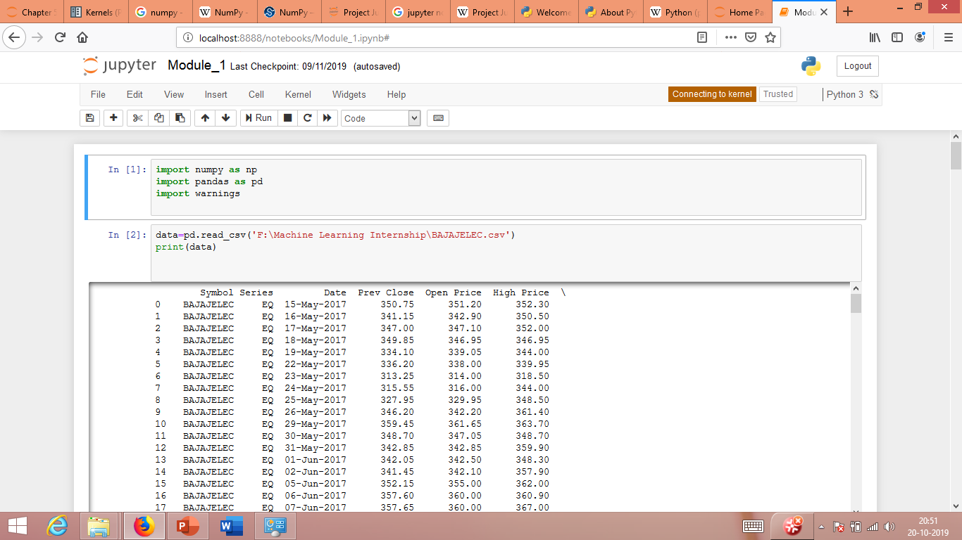

Slide 8
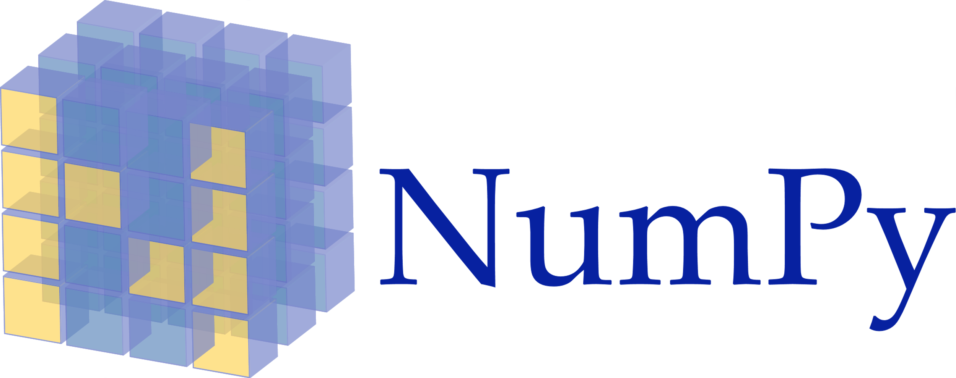
NumPy
NumPy is a library for the Python programming language, adding support for large, multi-dimensional arrays and matrices, along with a large collection of high-level mathematical functions to operate on these arrays.
Includes useful linear algebra, Fourier transform, and random number capabilities.
NumPy is open-source software and has many contributors.

Slide 9

MATPLOTLIB
Matplotlib is a Python 2D plotting library which produces publication quality figures in a variety of hardcopy formats and interactive environments across platforms.
Matplotlib can be used in Python scripts, the Python and IPython shells, the Jupyter notebook, web application servers, and four graphical user interface toolkits.
You can generate plots, histograms, power spectra, bar charts, errorcharts, scatterplots, etc., with just a few lines of code.

Slide 10
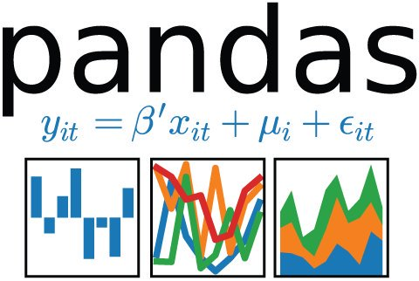
PANDAS
pandas is an open source, BSD-licensed library providing high-performance, easy-to-use data structures and data analysis tools for the Python programming language.
Python has long been great for data preparation, but less so for data analysis and modelling. pandas helps fill this gap, enabling you to carry out your entire data analysis workflow in Python without having to switch to a more domain specific language like R.
pandas allows importing data of various file formats such as csv, excel etc. pandas allows data manipulation operations such as groupby, join, merge, melt, concatenation as well as data cleaning features such as filling, replacing or imputing null values.

Slide 11

SEABORN
Seaborn is a library for making statistical graphics in Python.
It is built on top of matplotlib and closely integrated with pandas data structures.
Its dataset-oriented plotting functions operate on dataframes and arrays containing whole datasets and internally perform the necessary semantic mapping and statistical aggregation to produce informative plots.

Slide 12

SCIKIT LEARN
If you’re going to do Machine Learning in Python, Scikit Learn is the gold standard.
Built on the top of NumPy, SciPy, and matplotlib.
It provides a wide selection of supervised and unsupervised learning algorithms.
Simple and efficient tools for data mining and data analysis. It features various classification, regression and clustering algorithms including support vector machines, random forest, gradient boosting, k-means, etc.

Slide 13


DATA
Real world data is disorganised.
We cant expect a clean and formatted data as provided by Kaggle.
Data pre-processing is very crucial.
It could occupy 40%-70% of the whole workflow, just to clean the data to be fed to your models.
Efficient knowledge of spreadsheet applications like Microsoft Excel is required.
We have scrapped 4 datasets from espn cricinfo. ie; T20 rankings of teams as of October 2019, fixtures of 2020 world cup, teams’ history in previous world cups and T20 data set for matches played between 2010 to present.

Slide 14
Decision Tree Classification
A supervised learning algorithm. They can be used to solve both regression and classification problems.
It uses the tree representation to solve the problem in which each leaf node corresponds to a class label and attributes are represented on the internal node of the tree.
Decision tree concept is more to the rule based system.
Given the training dataset with targets and features, the decision tree algorithm will come up with some set of rules. The same set rules can be used to perform the prediction on the test dataset.

Slide 15
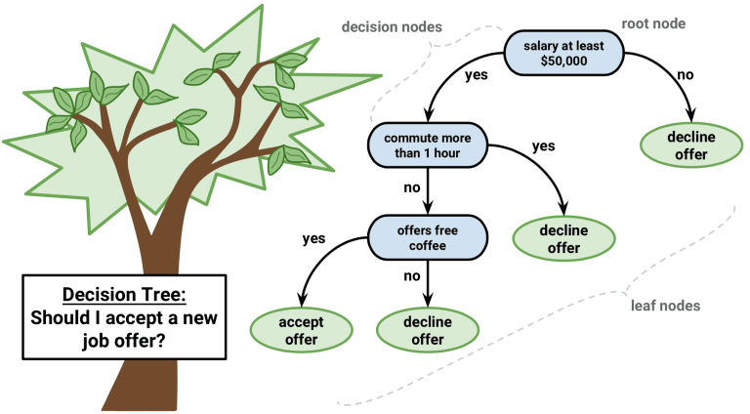
Basic Case Study

Slide 16
Random Forest Classification
A Random Forest is an ensemble technique capable of performing both regression and classification tasks with the use of multiple decision trees.
The basic idea behind this is to combine multiple decision trees in determining the final output rather than relying on individual decision trees.

Slide 17
Data Collection
Model Development
Data Exploration
Data Cleaning
Feature Engg & Selection
Comparison of Algorithms
Model Evaluation
WORKFLOW

Slide 18
FEATURE ENGINEERING
The most important part in the machine learning workflow.
Feature engineering is the process of transforming raw data into features that better represent the underlying problem to the predictive models, resulting in improved model accuracy on unseen data.
Since the algorithm is totally dependent on how we feed data into it, feature engineering should be given topmost priority for every machine learning project.

Slide 19
RELEVANCE OF PREDICTION MODELS
Growing volumes and types of data, and more interest in using data to produce valuable insights.
Faster, cheaper computers.
Easier-to-use software.

Slide 20
REFERENCE
https://towardsdatascience.com
https://towardsdatascience.com/machine-learning
https://dataaspirant.com

Slide 21
Thanks!

